Slide 1

An AI based SMART MIRROR for home automation
Presented by
NIROOP .B
MANJUNATHA .P. R
Guided by
LAKSHMINARAYAN .N
Assistant professor
Dept of BCA
VVFGC –Tumkur
YOUR REFLECTION IS NOT THE LIMIT !

Slide 2
What is Smart Mirror ?

Slide 3
An innovative framework used to convert a normal utility mirror into a smart interactive device.

Slide 4
Why Smart Mirror ?
You know the feeling…
Morning Rush
No time to check weather,traffic,latest news
The average person spends between 10-45 min everyday in front of a mirror
Looking up information costs time. Getting ready for work takes time. Why not combine them?

Slide 5
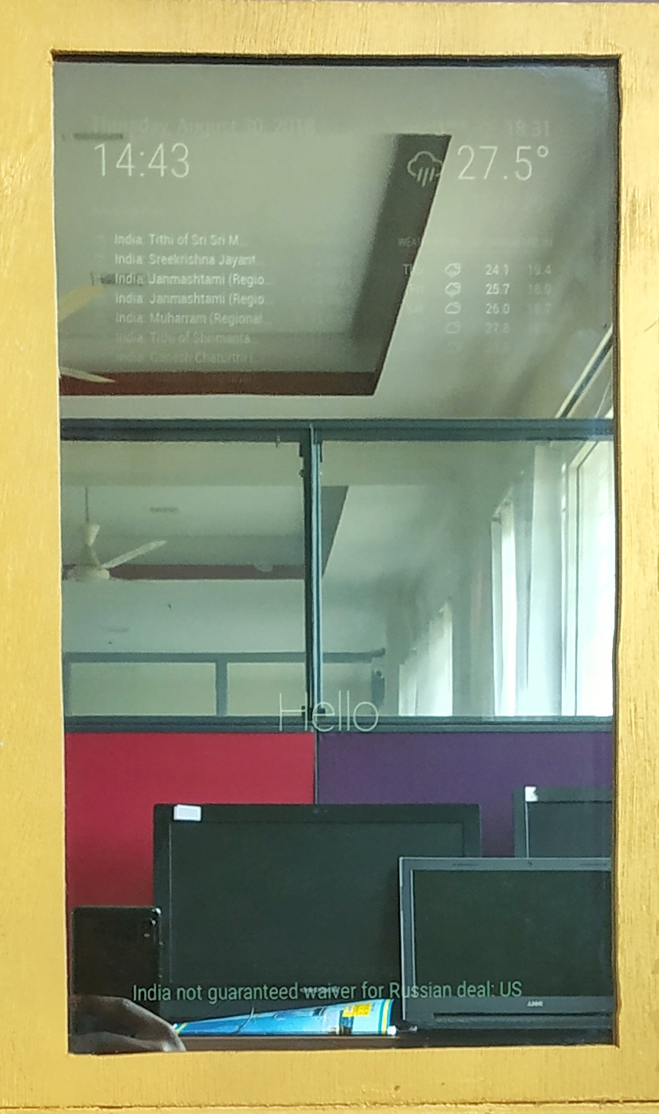
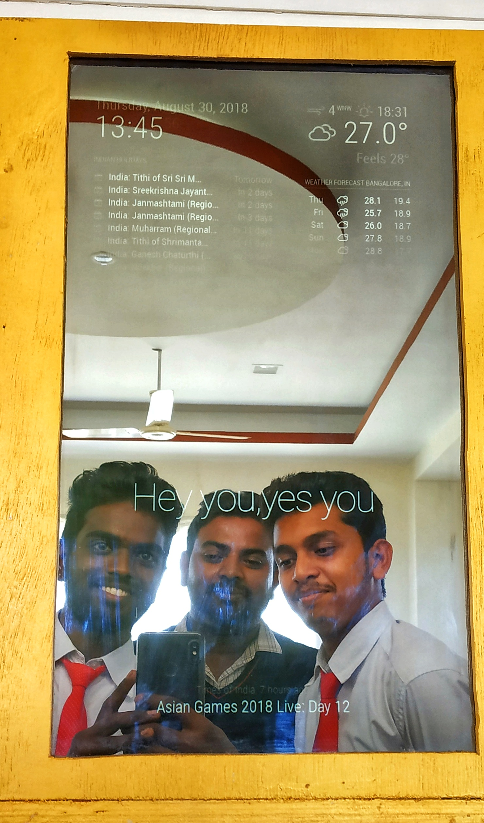
Prototype

Slide 6
Features
Connected to the internet
Date and Time
Weather, news and traffic information
Voice recognition
Voice commands

Slide 7

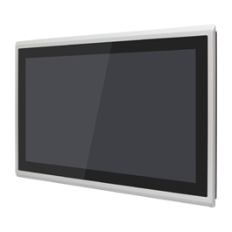

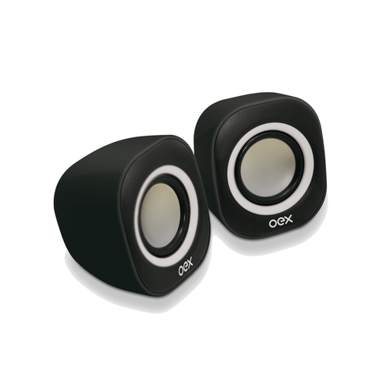

Hardware

Slide 8
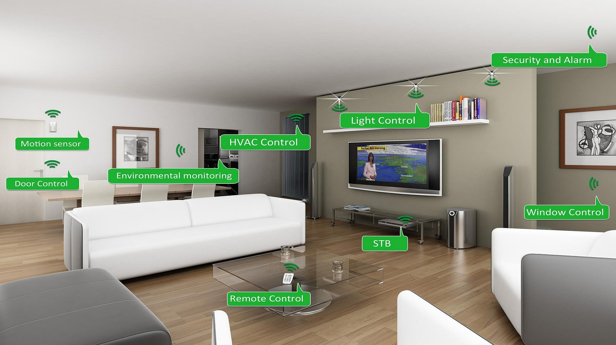
Smart Home
A smart home is a home that has highly advanced automated systems to control and monitor any function of a house like…

Slide 9
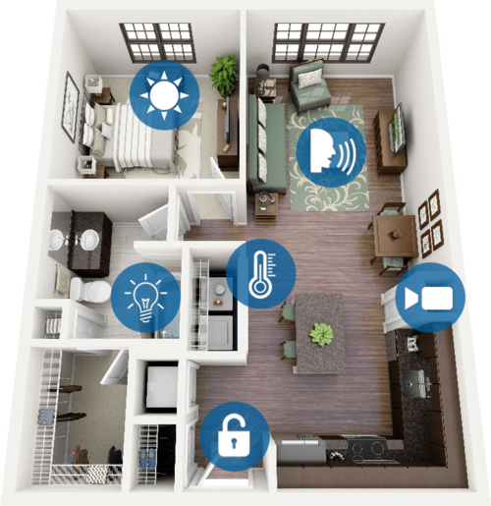
Smart Home
Lighting
Temperature control
Security
Widow and door operations

Slide 10
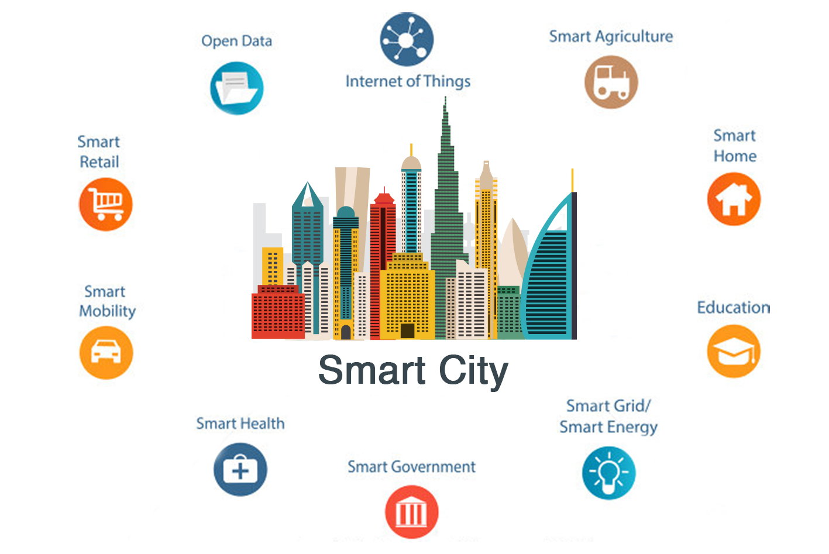
Continue..
If smart homes are constructed in large scale the ideology of smart city of our PM can be achieved

Slide 11
Market scope
Growing priority
Alternate for a traditional mirror
Effortless experience
Provides comfortable lifestyle
Creates opportunities to manufacturers

Slide 12
Implementations
Can be implemented in :
Shopping malls
Hospitals
Railway stations
Airports
People gathering places

Slide 13
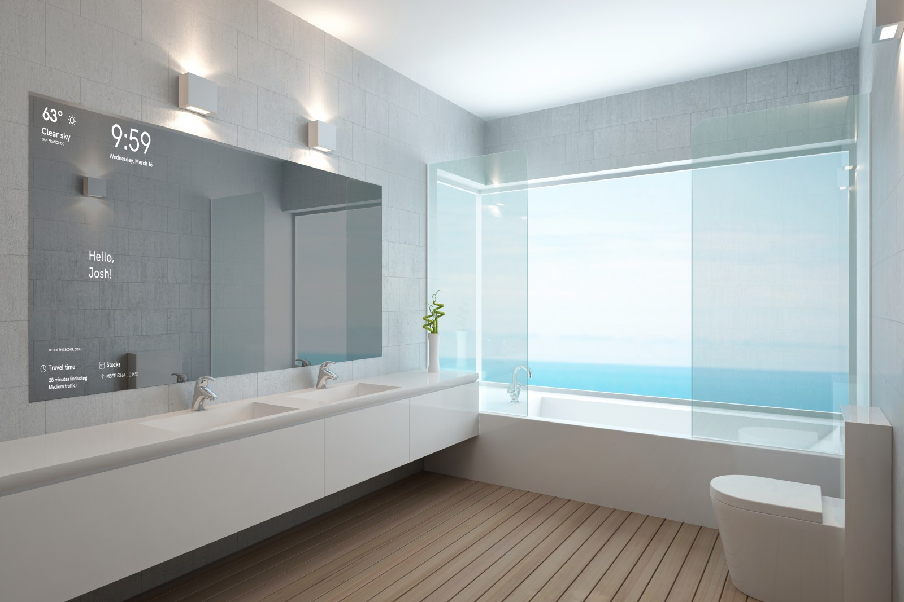
Future Scope
Person detection
Social media
Delivery tracking information
Make-up tutorial and simulation
Blends with interior design

Slide 14
Conclusion
Smart mirrors are part of an optimistic vision that imagines a world where screens and data are everywhere, ready to feed you whatever information you need at a moment’s notice.

Slide 15
THANK YOU

